Slide 1


GospelPreaching.com

Slide 2
System Background
CFTF Publications is a small publisher of religious books, tracts, and other media related to the Church of Christ.
Allen Bailey is the owner/operator.

Slide 3
System Background
The system is going to be an online portal for:
  CFTF's electronic resources (documents, audio, video, etc.) and
  a storefront for the company's published goods.
GospelPreaching.com

Slide 4
System Background
Along with the system's basic functions it will also provide the following:
  Ability to categorize and tag electronic materials
  Post and respond to questions (Q&A)
  Allow users to connect their profiles with social networking sites (Facebook, Twitter, etc.)
  Post comments
  “Like” articles.

Slide 5
Feasibility Study
Organizational and Cultural
  The owner, Allen Bailey, is the principle stakeholder and is very enthusiastic about the project.
  The only issue I can see arising would be if the system didn't have a simple enough of an interface. Usability was one point that he stressed, but I don't think it will cause any issues.

Slide 6
Feasibility Study
Technological Feasibility
  Security could be an issue since it is a web based system. Appropriate measures will need to be taken.
  Since Django is a web framework that I'm very familiar with, I don't think there will be any issues on the implementation side.

Slide 7
Feasibility Study
Schedule Feasibility
  Since the project has a sort time frame of a single semester and I am the only analyst/developer, it will be important to stick to the project management plans.
  However, with due diligence I think the schedule is certainly feasible.

Slide 8
Feasibility Study
Resource Feasibility
  The only resources here are my time and the hosting fees once the project goes live. After talking with Allen, resource feasibility seems reasonable as well.

Slide 9
Financial Feasibility

Slide 10
Event Table

Slide 11
Event Table

Slide 12
Use Case Diagrams

Slide 15
Domain Model Class Diagram

Slide 17
Key Use Case Description

Slide 19
Initial Menu Hierarchy
Articles
  Categories
  Tags
  Authors
Questions and Answers
  Ask a Question
Users
Book Store
  Products
  Cart
Login
My Profile
  Update User Profile
  Delete User

Slide 20
Initial Menu Hierarchy
Administration
  Articles
    Add Article
    Update Article
    Delete Article
  Authors
    Add Author
    Update Author
    Delete Author
  Categories
    Create Category
    Update Category
    Delete Category
  Users
    Unapproved Users
    Delete User
  Questions
    Update Question
    Delete Question
  Products
    Add Product
    Update Product
    Delete Product
  Orders
    Unshipped Orders
    Adjust Order
    Recent Orders

Slide 21
Article Index Page

Slide 22
Articles by Category

Slide 23
Articles by Author

Slide 24
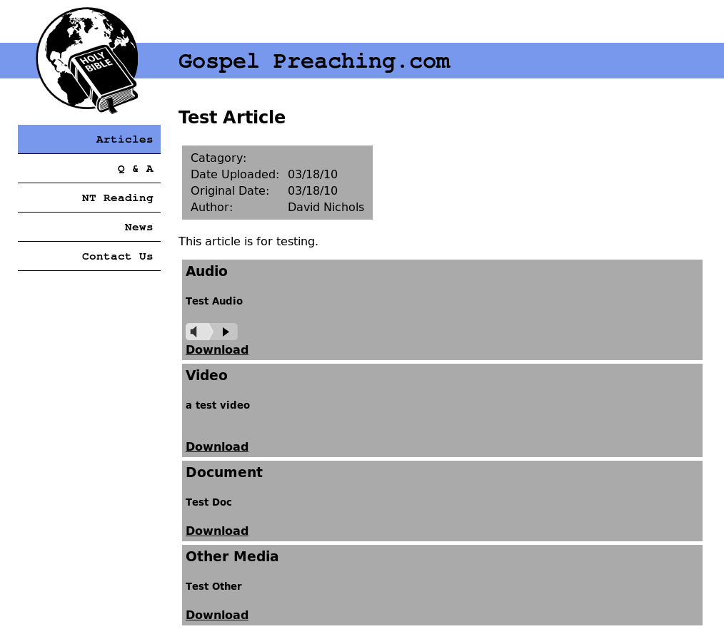
Article Details

Slide 25
Administration View

Slide 26
Database View

Slide 27
Technology and Working Environment
The application architecture I am using is a modified version of the MVC approach to web development unique to the Django platform.
The models, or data access takes place in models.py. No SQL strings are ever directly manipulated by user created code; the Django framework handles all of that. The structure of the classes is simply defined in the model and all the SQL string conversion are taken care of automatically based on the connection settings in the main settings.py file.

Slide 28
Technology and Working Environment
The controller code is mostly handled by the framework. However, there are configuration settings that manage the functionality of the controller layer. The most notable of these is the urls.py file which defines which view to display.
According to the Django's interpretation of MVC, the views.py file manages the view layer. This interpretation defines the view layer as making the decision of what to display, instead of how to display it. This logic would traditionally be found in the controller layer in other MVC frameworks, which is one area where Django differs.

Slide 29
Technology and Working Environment
The final piece of the puzzle is the template system. The templates define how the information is to be displayed, and consist of HTML files with template tags. However, Django does not consider these to be part of any of the three layers.
The code for the system will strongly object-oriented and dynamic thanks to the Python language.
I've provided a sequence diagram for the View Article use case to illustrate this structure as well as possible.

Slide 30
Technology and Working Environment

Slide 31
Technology and Working Environment
Development Machine
SVN Server
Publicly Accessible Dev Servers
  Local Django test server
  Public FastCGI server

